Slide 1
Enterprise-Scale Real-Time E-Commerce Data Platform
Team Members:
Roll Number | Name
2420030478 | T. Viswanath Reddy
2420030300 | Siril Punna
2420030290 | D. Kamal Kumar
Faculty: Dr. N Sirisha

Slide 2
PROJECT ABSTRACT:
The Enterprise-Scale Real-Time E-Commerce Data Platform is a scalable data engineering solution designed to collect, process, store, and analyze large volumes of e-commerce data in real time. Modern e-commerce platforms continuously generate massive amounts of data from customer interactions, product views, orders, payments, inventory updates, clickstream activity, and delivery operations. Traditional batch-based systems often struggle to provide timely insights from this continuously generated data.
The proposed platform integrates real-time streaming and batch data processing to build a unified data pipeline. E-commerce events are collected from multiple sources and ingested using Apache Kafka, followed by real-time processing using Apache Spark Structured Streaming. Raw data is stored in a cloud-based data lake using Amazon S3, where it follows a Bronze, Silver, and Gold medallion architecture for efficient data management. Apache Airflow is used to orchestrate batch workflows, while a data warehouse such as Amazon Redshift or Snowflake stores structured, business-ready datasets for analytical queries.
The platform provides real-time analytics for important business metrics such as sales revenue, order volume, customer activity, product performance, inventory levels, conversion rates, and cart abandonment. Interactive dashboards can be developed using Power BI or Tableau to help organizations make faster and data-driven decisions. The architecture also incorporates data quality validation, security, fault tolerance, scalability, and monitoring to support enterprise-level workloads.
Overall, the project demonstrates how modern data engineering technologies can be combined to create a reliable, scalable, and real-time e-commerce analytics platform, enabling businesses to transform raw operational data into actionable insights and improve customer experience, operational efficiency, and decision-making.

Slide 3
INTRODUCTION:
The Enterprise-Scale Real-Time E-Commerce Data Platform is a modern data engineering project designed to manage and analyze the massive volume of data generated by online e-commerce platforms. Every interaction in an e-commerce system, such as product searches, clicks, cart additions, orders, payments, reviews, and inventory updates, generates valuable data. Processing this data efficiently is essential for understanding customer behavior, monitoring business performance, and making real-time decisions.
Traditional data processing systems mainly depend on batch processing, where data is collected and analyzed at fixed intervals. Although this approach is useful for historical reporting, it cannot provide immediate insights into rapidly changing events. For example, an e-commerce company may need to identify a sudden increase in product demand, detect suspicious transactions, or monitor inventory levels immediately rather than waiting for the next day's report.
This project addresses these challenges by implementing a unified batch and real-time data platform. Data from multiple sources is ingested through Apache Kafka, processed using Apache Spark Structured Streaming, and stored in a scalable cloud data lake using Amazon S3. The data is organized using the Medallion Architecture, consisting of Bronze, Silver, and Gold layers. Apache Airflow is used to automate and manage batch data workflows, while a data warehouse such as Amazon Redshift or Snowflake provides optimized storage for analytical workloads.
The processed data can be visualized through Power BI or Tableau dashboards, providing real-time insights into revenue, orders, customer activity, product performance, inventory, and other key business metrics. The platform is designed with scalability, fault tolerance, data quality, security, and performance in mind, allowing it to handle increasing volumes of e-commerce data.
Overall, the project demonstrates the application of modern data engineering, cloud computing, streaming technologies, and analytics to build an enterprise-ready platform capable of converting large volumes of raw e-commerce data into meaningful and actionable business insights.

Slide 4
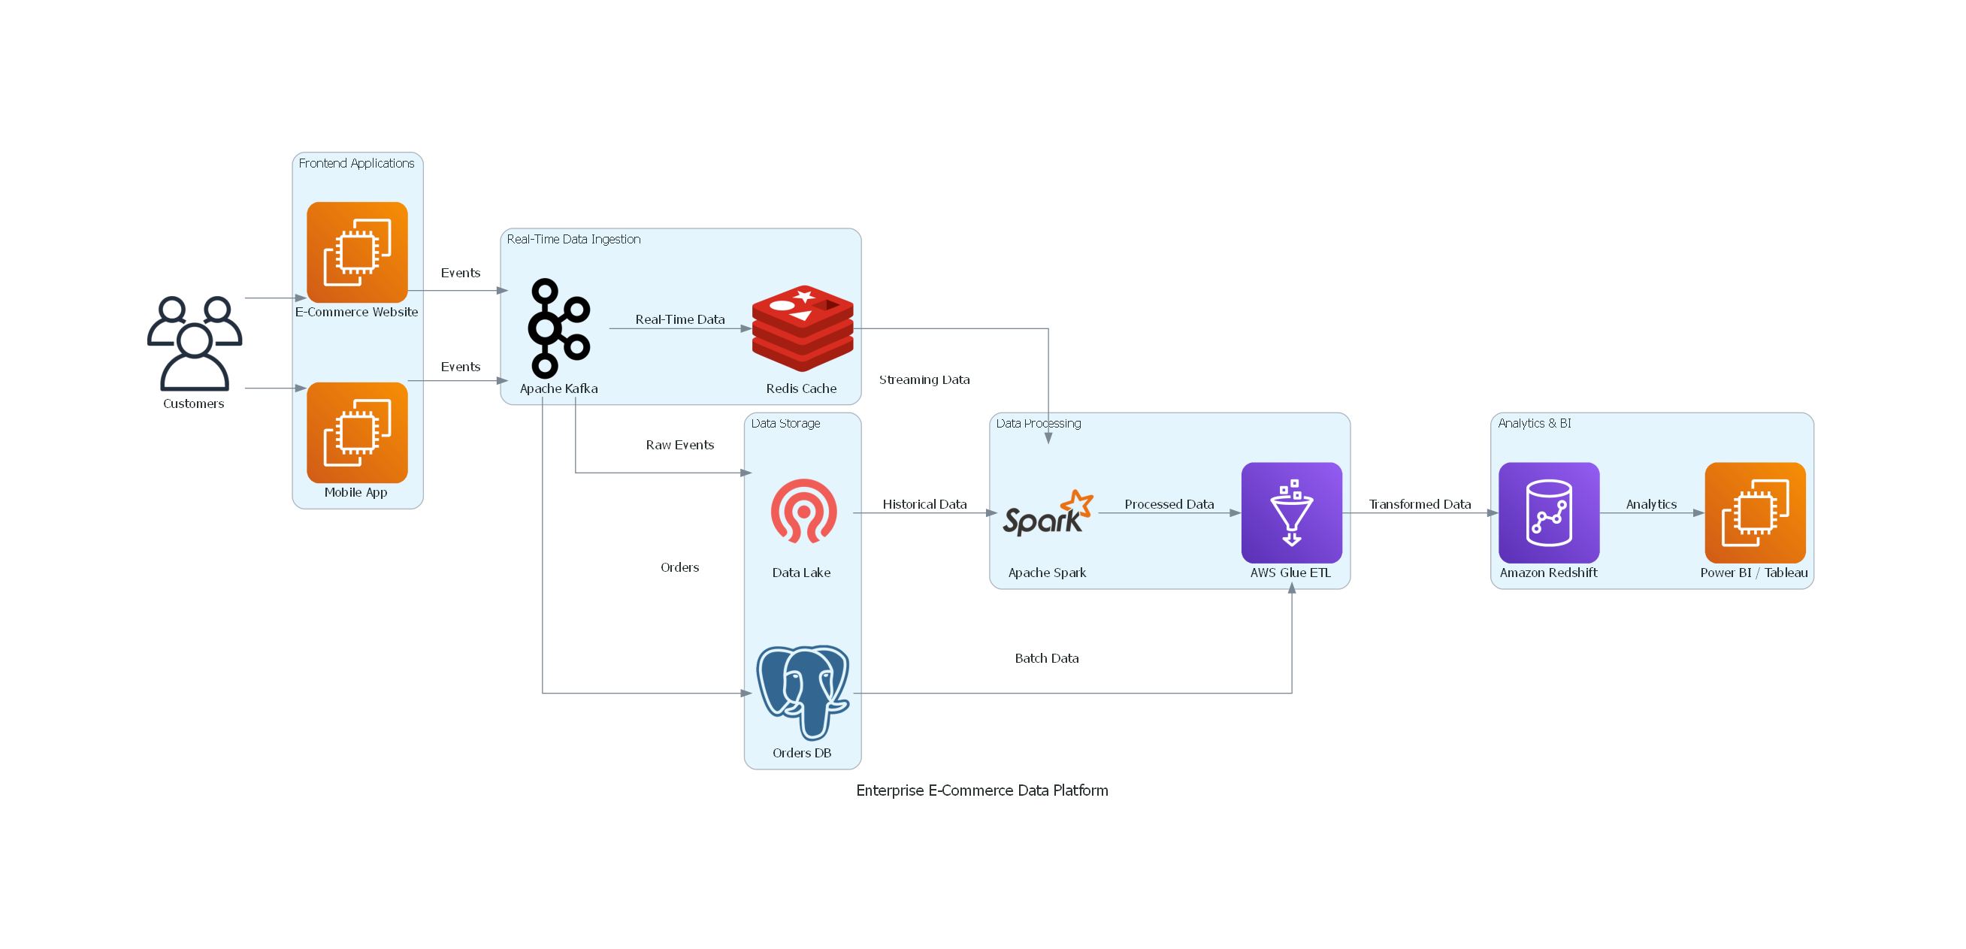
Workflow:

Slide 5
Tools & Technologies
The project uses Python, Apache Kafka, Apache Spark, and Apache Airflow for data ingestion, real-time streaming, processing, and workflow orchestration. Amazon S3 is used as the cloud data lake, while PostgreSQL and Amazon Redshift/Snowflake are used for structured storage and analytics. Power BI/Tableau provides interactive dashboards and business insights, while Docker and GitHub support deployment, version control, and collaboration.

Slide 6
THANK YOU

